Slide 1



CS Bridge, Lecture 1 Welcome to CS Bridge!

Slide 2
Welcome to CS Bridge!
We are here to share with you our love for programming!
A joint effort
Our goal: form a community of people to learn and teach programming together
Notes:
>150 students
>20 SLs

Slide 3
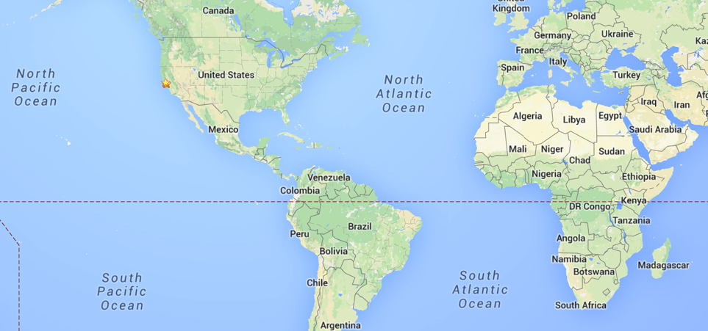
Bridging The World

Slide 4

Nice to meet you!
Hi! I’m Ali.
Notes:
I want to introduce my right-hand man

Slide 5
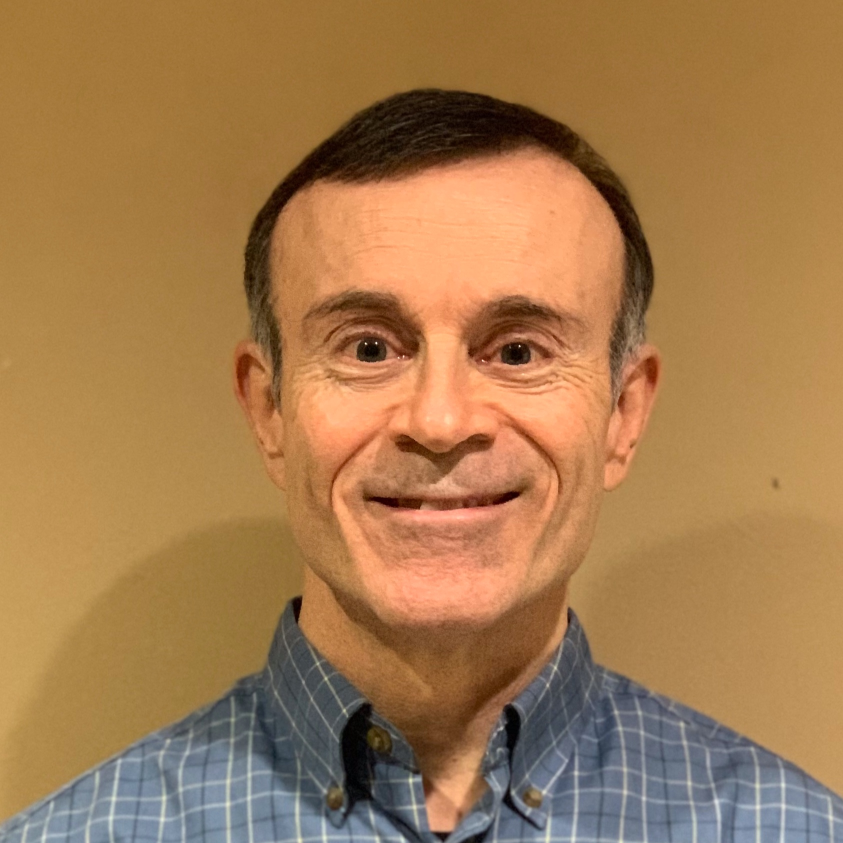
Nice to meet you!
Hi! I’m Doug.
Notes:
I want to introduce my right-hand man

Slide 6
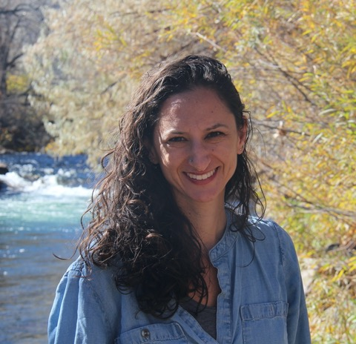
Nice to meet you!
Hi! I’m Yosefa.
Notes:
I want to introduce my right-hand man

Slide 7

Nice to meet you!
Hi! I’m Emily.
Notes:
I want to introduce my right-hand man

Slide 8
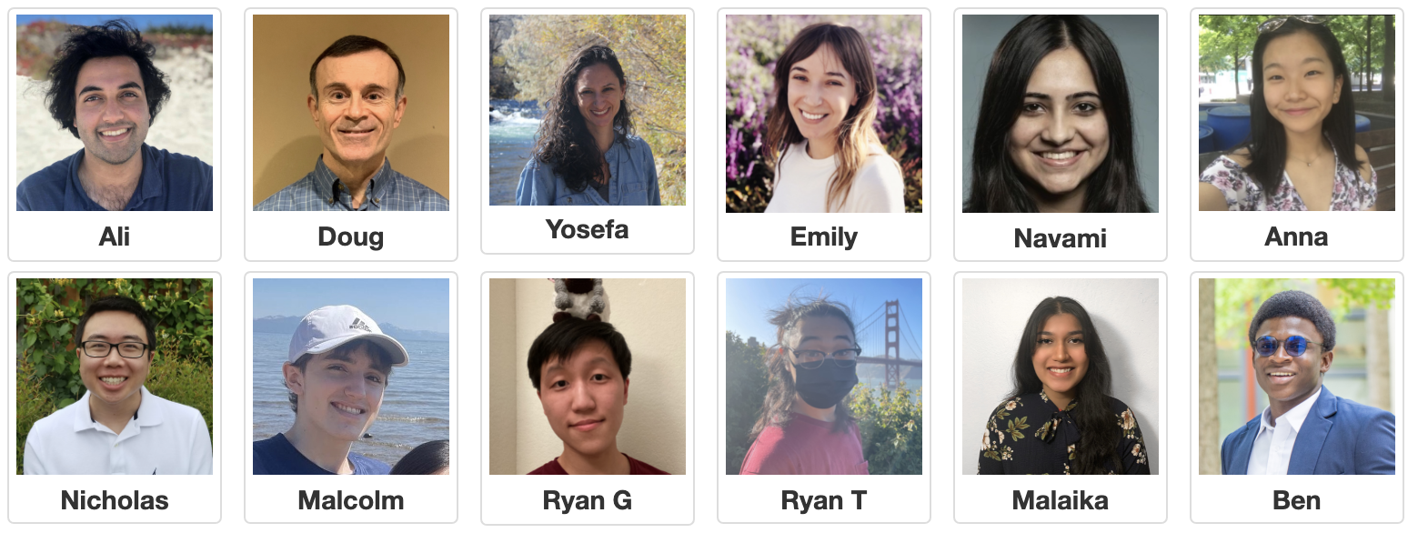
Nice to meet you!
Hina
Zahira

Slide 9

Lecture Plan
Welcome to CS Bridge!
Course information
Meet Karel the Robot
Defining new commands
For loops

Slide 10
Lecture Plan
Welcome to CS Bridge!
Course information
Meet Karel the Robot
Defining new commands
For loops

Slide 11
CS Bridge on Zoom
You are encouraged to share video!
Post questions/comments/followups in the Zoom chat. We’ll take periodic “question breaks” to address them, and have teachers monitoring the chat during the lecture. Everyone is muted by default.

Slide 12
Course Website
ohlone.csbridge.org

Slide 13
Ed Forum
We are using a website called Ed for asking and answering questions.
You can post questions there, and we or other students can answer them.
If you haven’t already, check your email for your invite to join Ed.
2 Ed Groups:
CS Bridge USA (main group)
Your Section

Slide 14
CS Bridge Structure – Learn By Doing
Lecture – Where we introduce new concepts!
Quickstart / Tea Time – Right after each lecture with your section group. Time for you to play around with the material on your own computers and mingle with other students.
Section – Right after evening quickstart, with your section group. You will work as a group with your Section Leader to solve practice problems.
Office Hours / Work – Right after the morning quickstart and the evening section. Your own time to work on the projects and sign up for office hours with the Section Leaders if you need help.
At the end of the morning and evening segments, submit your work!

Slide 15
Section Leader
Section Leaders will…
Lead your daily section and quickstart times
Help you when you have questions in Office Hours and on Ed
And much more…
Hina
Zahira
Notes:
Take advantage of them!

Slide 16
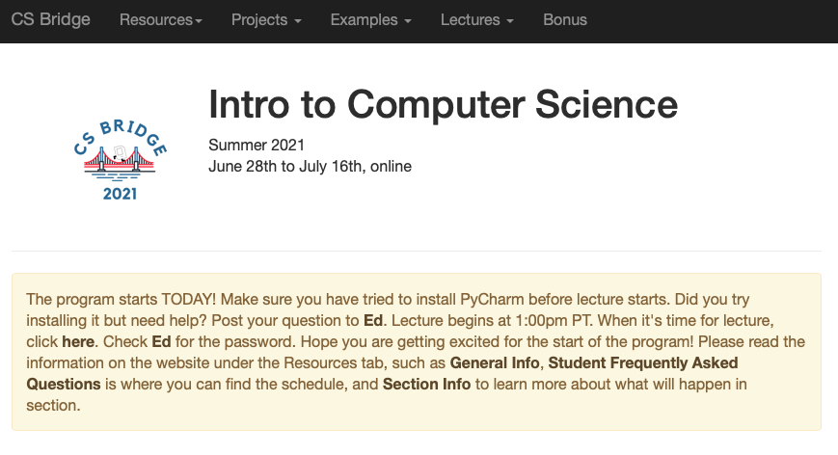
The Website Tells You Where To Go!

Slide 17
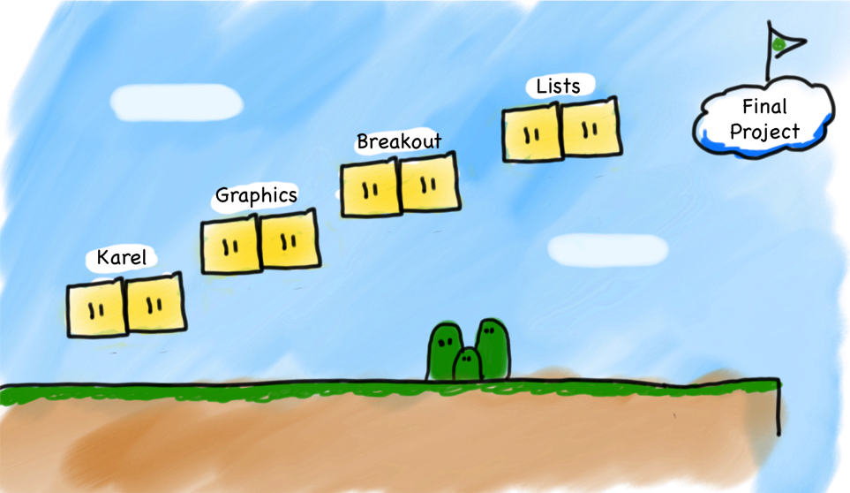
What Will We Learn?
Breakout
Graphics
Console
Karel
Notes:
Same material as Stanford’s class

Slide 18
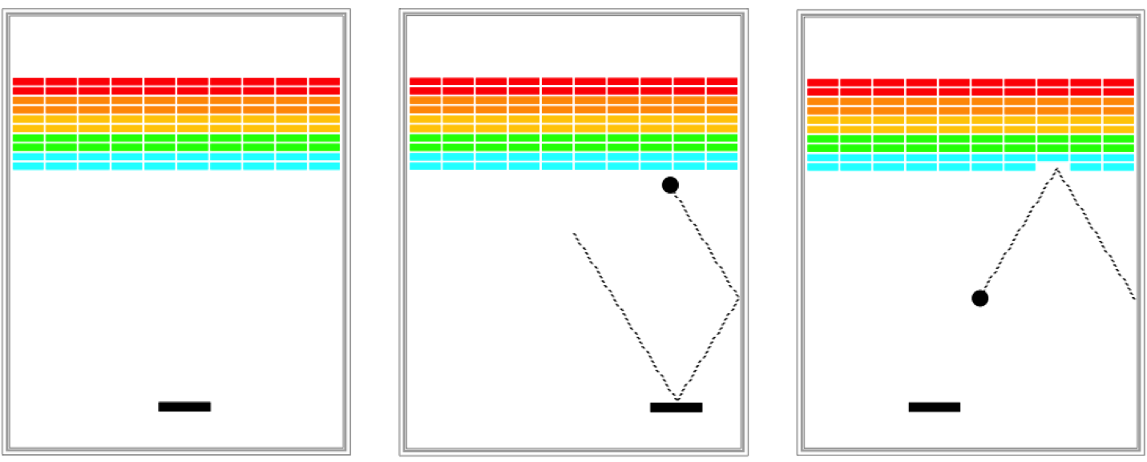
Breakout

Slide 19
Prerequisites
None! We assume you have never programmed before.

Slide 20
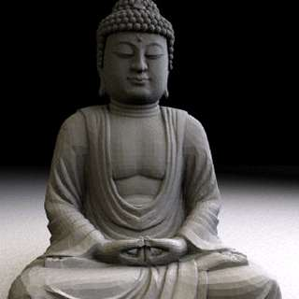
Art Of Computer Science
CS Bridge covers software engineering principles – much more than just programming
Writing a program is like writing an essay
Need a language (Python)
But just knowing the language doesn’t make you a good essay writer
Programming is a tool you can use to do amazing things!

Slide 21
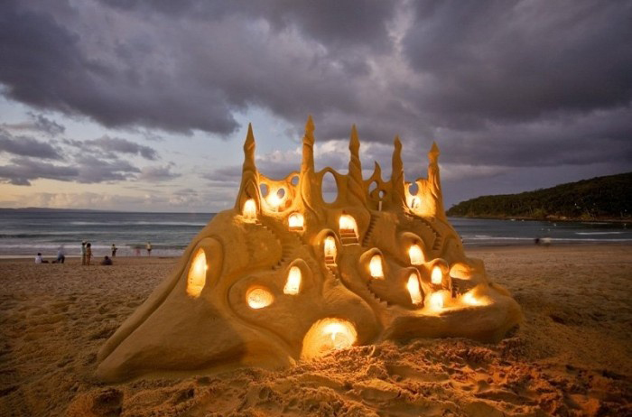
The Joy Of Building

Slide 22

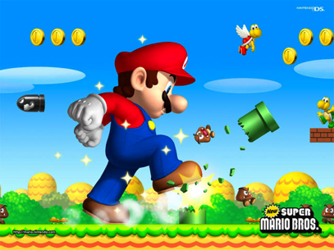

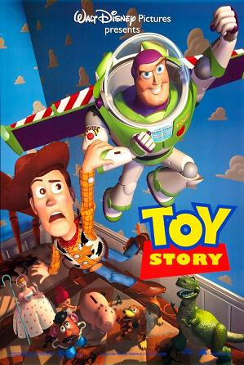
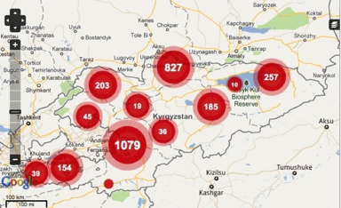
The Joy Of Building

Slide 23
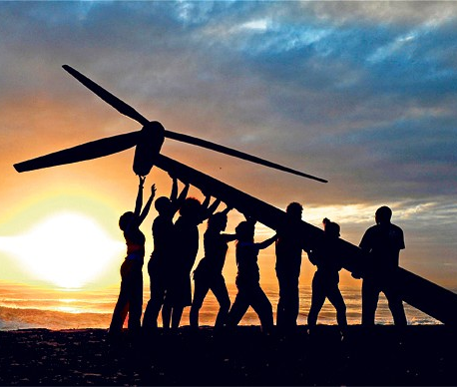
Strive For Everyone To Succeed
We want all of you to be successful!
You are not competing against anyone but yourself.
Learning programming is hard! We are here to help you. Please post on Ed or talk to your Section Leader if you are having trouble.
Your most important task: show up!

Slide 24
Lecture Plan
Welcome to CS Bridge!
Course information
Meet Karel the Robot
Defining new commands
For loops

Slide 25
Meet Karel the Robot!
Notes:
Karel – from Karel Chopek, who invented the word “robot”
Old Mac with leg out its back

Slide 26
Meet Karel the Robot!
Hello!
¡Hola!
Merhaba!
Ahoj!
Notes:
Karel speaks Java! (not english)

Slide 27
Meet Karel the Robot!
Notes:
Karel speaks Java! (not english)

Slide 28
Karel's World
3
.
.
.
.
.
2
.
.
.
.
.
1
.
.
.
.
.
1
2
3
4
5

Slide 29

Karel's World
3
.
.
.
.
.
2
.
.
.
.
.
1
.
.
.
.
.
1
2
3
4
5

Slide 30
Karel's World
3
.
.
.
.
.
2
.
.
.
.
.
Hello, world!
1
.
.
.
.
.
1
2
3
4
5

Slide 31
Karel's World
3
.
.
.
.
.
2
.
.
.
.
.
1
.
.
.
.
.
1
2
3
4
5

Slide 32
Streets (rows)
3
.
.
.
.
.
2
.
.
.
.
.
1
.
.
.
.
.
1
2
3
4
5
Each row is called a street.

Slide 33
Avenues (columns)
3
.
.
.
.
.
2
.
.
.
.
.
1
.
.
.
.
.
1
2
3
4
5
Each column is called an avenue.

Slide 34
Corners (locations)
3
.
.
.
.
.
2
.
.
.
.
.
1
.
.
.
.
.
The intersection of a street and an avenue is a corner.
1
2
3
4
5

Slide 35
Walls
3
.
.
.
.
.
2
.
.
.
.
.
1
.
.
.
.
.
1
2
3
4
5
Karel cannot move through walls.

Slide 36
Beepers
3
.
.
.
.
.
2
.
.
.
.
.
1
.
.
.
.
.
Beepers mark locations in Karel's world. Karel can pick them up and put them down.
1
2
3
4
5

Slide 37
Karel Knows 4 Commands
move()
turn_left()
put_beeper()
pick_beeper()
Notes:
Don’t be deceived! Build complex things from simple commands

Slide 38
Karel Knows 4 Commands
move()
turn_left()
“functions”
put_beeper()
pick_beeper()

Slide 39
Commands: move
move makes Karel move forward one square in the direction it is facing.
Karel Commands
3
.
.
.
.
.
move()
turn_left()
pick_beeper()
put_beeper()
2
.
.
.
.
.
1
.
.
.
.
.
.
1
2
3
4
5

Slide 40
Commands: move
move makes Karel move forward one square in the direction it is facing.
Karel Commands
3
.
.
.
.
.
move()
turn_left()
pick_beeper()
put_beeper()
2
.
.
.
.
.
1
.
.
.
.
.
.
1
2
3
4
5

Slide 41
Commands: turn_left
turn_left makes Karel rotate 90° counter-clockwise.
There is no turn_right command. (Why not?)
Karel Commands
3
.
.
.
.
.
move()
turn_left()
pick_beeper()
put_beeper()
2
.
.
.
.
.
1
.
.
.
.
.
.
1
2
3
4
5

Slide 42
Commands: turn_left
turn_left makes Karel rotate 90° counter-clockwise.
There is no turn_right command. (Why not?)
Karel Commands
3
.
.
.
.
.
move()
turn_left()
pick_beeper()
put_beeper()
2
.
.
.
.
.
1
.
.
.
.
.
.
1
2
3
4
5

Slide 43
Commands: pick_beeper
pick_beeper makes Karel pick up the beeper at the current corner. Karel can hold multiple beepers at a time in its "beeper bag".
Karel Commands
3
.
.
.
.
.
move()
turn_left()
pick_beeper()
put_beeper()
2
.
.
.
.
.
1
.
.
.
.
.
.
1
2
3
4
5

Slide 44
Commands: pick_beeper
pick_beeper makes Karel pick up the beeper at the current corner. Karel can hold multiple beepers at a time in its "beeper bag".
Karel Commands
3
.
.
.
.
.
move()
turn_left()
pick_beeper()
put_beeper()
2
.
.
.
.
.
1
.
.
.
.
.
.
1
2
3
4
5

Slide 45
Commands: put_beeper
put_beeper makes Karel put a beeper down at its current location.
pick_beeper and put_beeper are used to move beepers around.
Karel Commands
3
.
.
.
.
.
move()
turn_left()
pick_beeper()
put_beeper()
2
.
.
.
.
.
1
.
.
.
.
.
.
1
2
3
4
5
Notes:
beeper bag

Slide 46
Commands: put_beeper
put_beeper makes Karel put a beeper down at its current location.
pick_beeper and put_beeper are used to move beepers around.
Karel Commands
3
.
.
.
.
.
move()
turn_left()
pick_beeper()
put_beeper()
2
.
.
.
.
.
1
.
.
.
.
.
.
1
2
3
4
5
Notes:
beeper bag

Slide 47
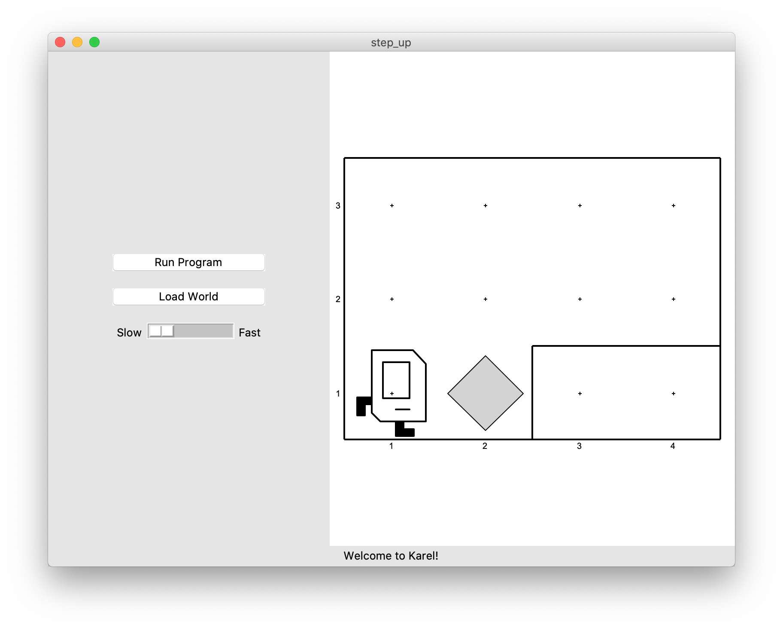
Our First Karel Program
Before:

Slide 48
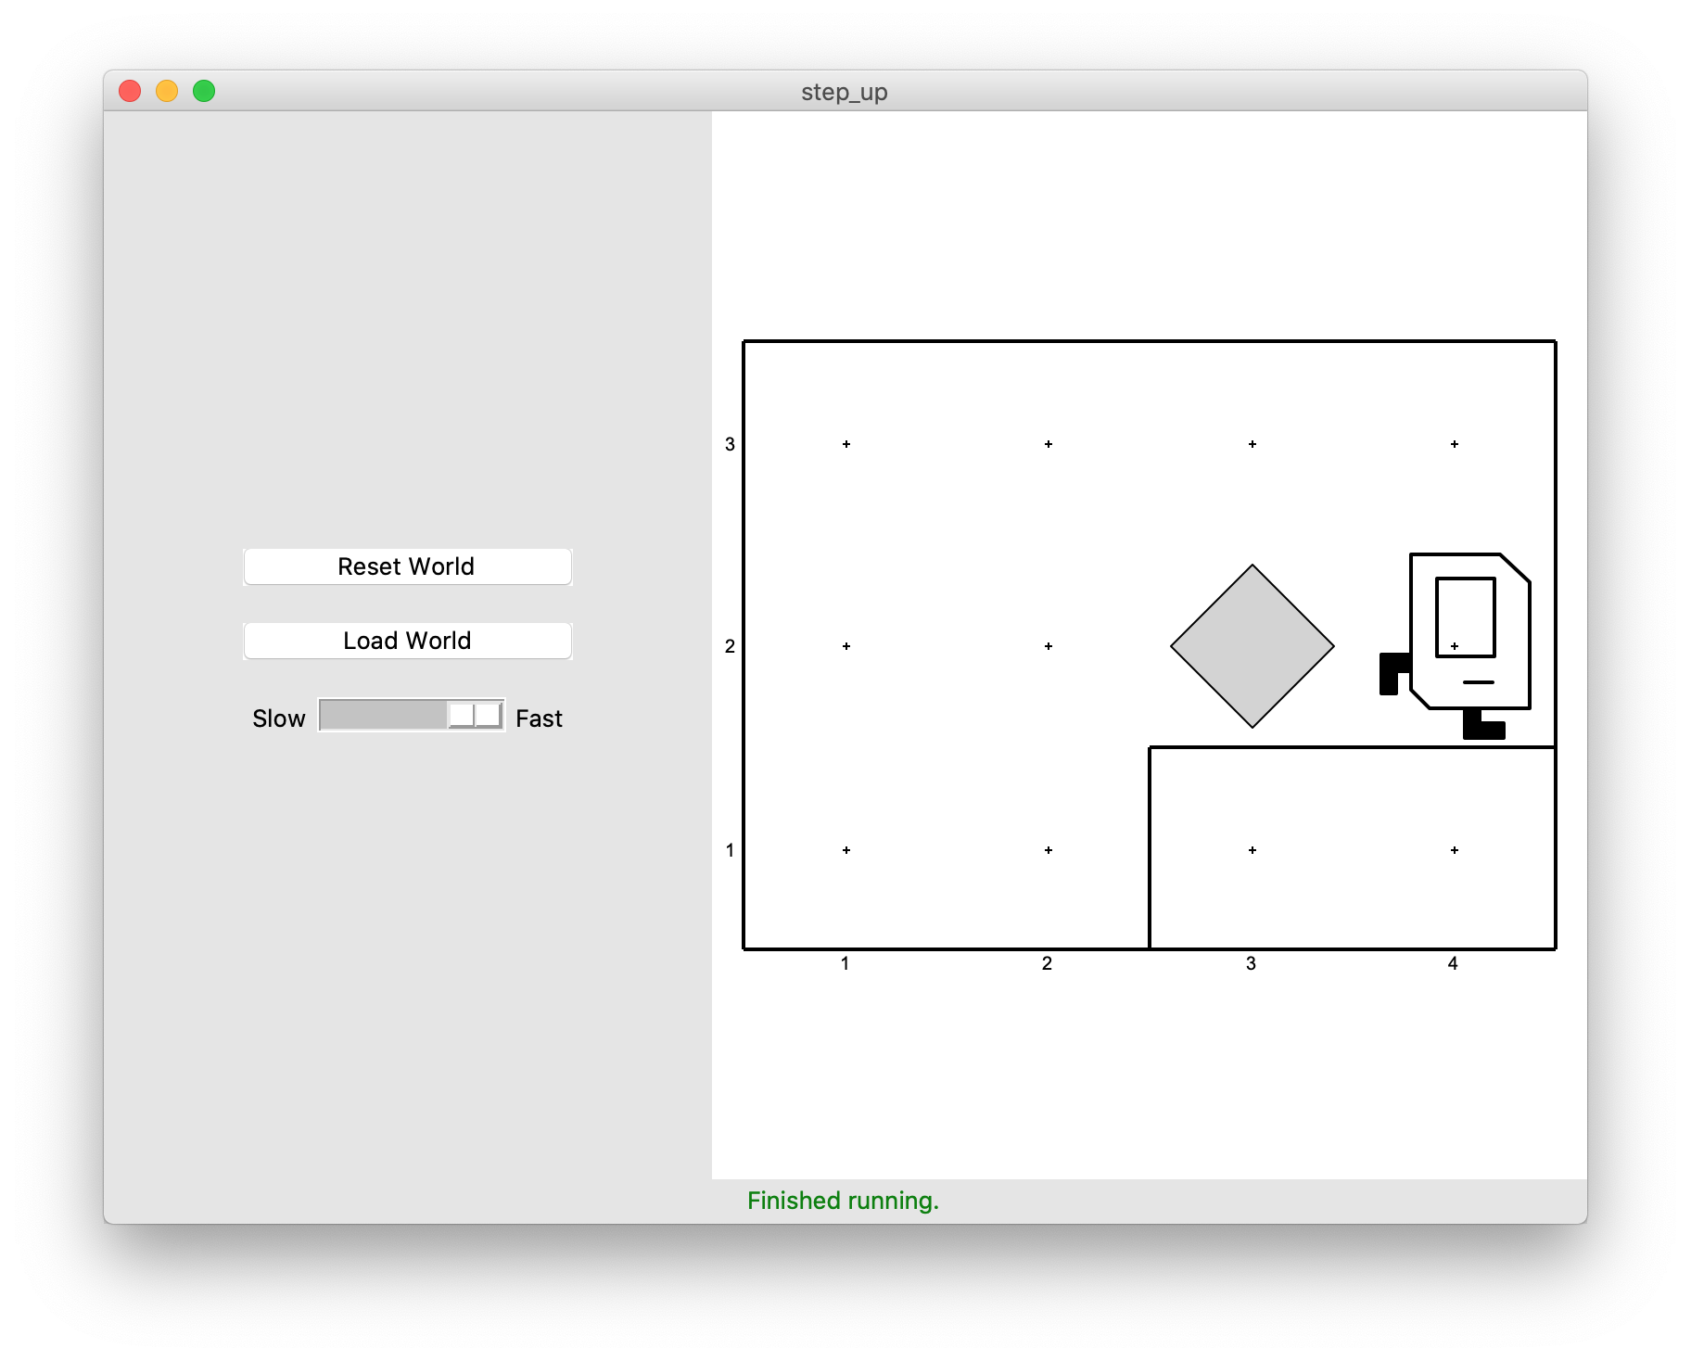
Our First Karel Program
After:

Slide 49
Demo

Slide 50
Anatomy Of A Program
def main():
move()
pick_beeper()
move()
turn_left()
move()
turn_left()
turn_left()
turn_left()
move()
put_beeper()
move()
if __name__ == "__main__": run_karel_program()
This piece of the program's source code is called a function.

Slide 51
Anatomy Of A Program
def main():
move()
pick_beeper()
move()
turn_left()
move()
turn_left()
turn_left()
turn_left()
move()
put_beeper()
move()
if __name__ == "__main__": run_karel_program()
This line of code gives the name of the function
(here, main)

Slide 52
Anatomy Of A Program
def main():
move()
pick_beeper()
move()
turn_left()
move()
turn_left()
turn_left()
turn_left()
move()
put_beeper()
move()
if __name__ == "__main__": run_karel_program()
This is called a code block. Python requires that code blocks be indented one level.

Slide 53
Lecture Plan
Welcome to CS Bridge!
Course information
Meet Karel the Robot
Defining new commands
For loops

Slide 54
Defining New Commands
We can make new commands (or functions) for Karel. This lets us decompose our program into smaller pieces that are easier to understand.
def name():
statement
statement
...
For example:
def turn_right():
turn_left()
turn_left()
turn_left()

Slide 55
Lecture Plan
Welcome to CS Bridge!
Course information
Meet Karel the Robot
Defining new commands
For loops

Slide 56
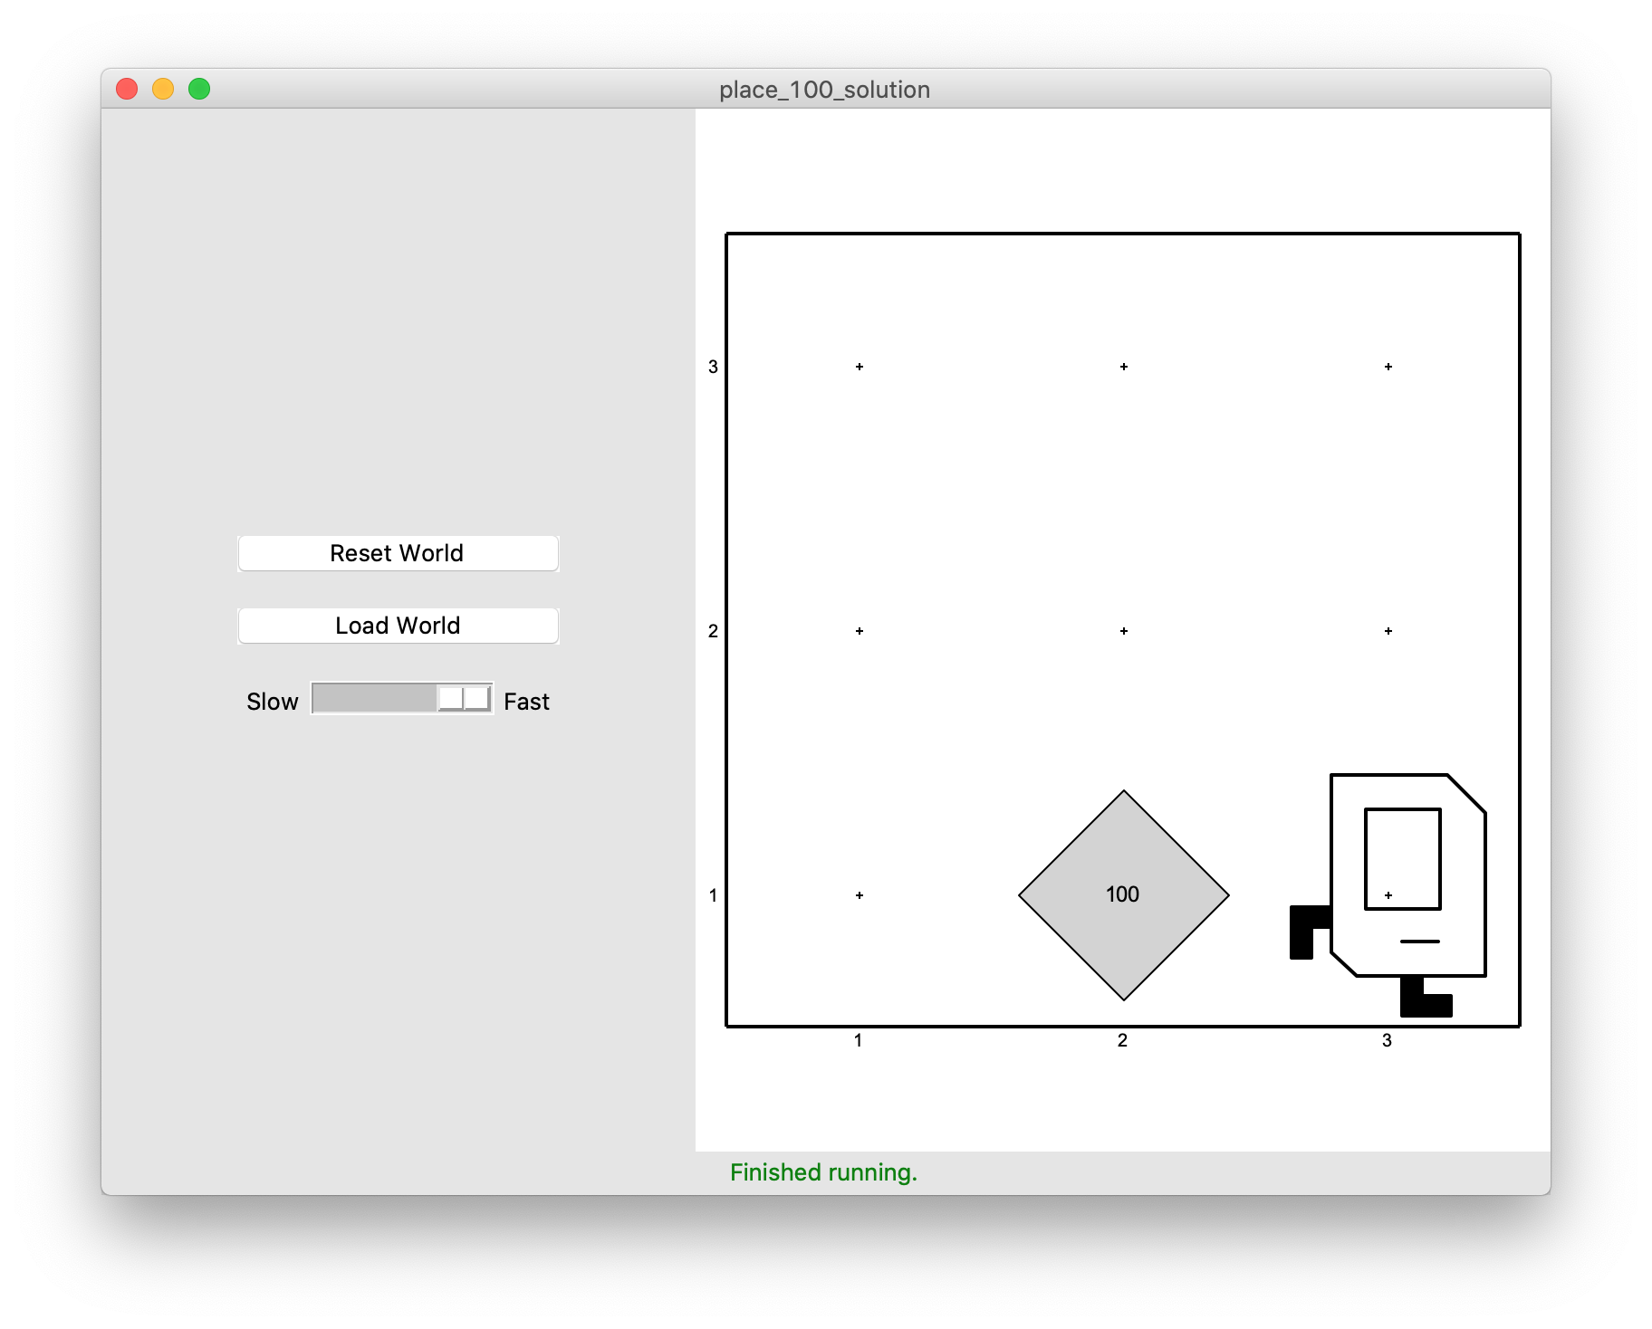
For Loops
I want to make Karel put 100 beepers down on a corner. How do I do this?

Slide 57
For Loops
Can’t just say:
move()
put_beeper()
put_beeper()
put_beeper()
...
move()
This is too repetitive! Plus, it’s difficult to change (e.g. to 25 beepers).

Slide 58
For Loops
Instead, use a for loop:
for i in range(count):
statement
statement
...
Repeats the statements in the body count times.
Notes:
Executes statements in order – NOT repeating each one individually

Slide 59
For Loops
Now we can say:
move()
for i in range(100):
put_beeper()
move()
This is less repetitive and is easier to change (e.g. to 25 beepers).

Slide 60
For Loops and Indentation
for i in range(count):
statements # note indenting
def turn_right():
for i in range(3):
turn_left() # note indenting

Slide 61
Lecture Recap
Welcome to CS Bridge!
Course information
Meet Karel the Robot
Defining new commands
For loops

Slide 62
Welcome to CS Bridge!
We are here to share with you our love for programming!
An exciting experiment about online teaching
A joint effort
Our goal: form a community of people to learn and teach programming together
Notes:
>150 students
>20 SLs

Slide 63
What’s Next?
Time for your section’s quickstart time!
Check your section’s Ed group for more information
We hope you will be able to get set up if you aren’t already, and complete at least collect newspaper Karel. Have fun!

Slide 64
Extra: Beeper Square

Slide 65

For Loop Example: Beeper Square
def main(): for i in range(4): put_beeper() move() turn_left()

Slide 66
For Loop Example: Beeper Square
def main(): for i in range(4): put_beeper() move() turn_left()

Slide 67
For Loop Example: Beeper Square
def main(): for i in range(4): put_beeper() move() turn_left()
First time through the loop

Slide 68

For Loop Example: Beeper Square
def main(): for i in range(4): put_beeper() move() turn_left()
First time through the loop

Slide 69
For Loop Example: Beeper Square
def main(): for i in range(4): put_beeper() move() turn_left()
First time through the loop

Slide 70
For Loop Example: Beeper Square
def main(): for i in range(4): put_beeper() move() turn_left()
First time through the loop

Slide 71
For Loop Example: Beeper Square
def main(): for i in range(4): put_beeper() move() turn_left()
Second time through the loop

Slide 72
For Loop Example: Beeper Square
def main(): for i in range(4): put_beeper() move() turn_left()
Second time through the loop

Slide 73
For Loop Example: Beeper Square
def main(): for i in range(4): put_beeper() move() turn_left()
Second time through the loop

Slide 74
For Loop Example: Beeper Square
def main(): for i in range(4): put_beeper() move() turn_left()
Second time through the loop

Slide 75
For Loop Example: Beeper Square
def main(): for i in range(4): put_beeper() move() turn_left()
Third time through the loop

Slide 76
For Loop Example: Beeper Square
def main(): for i in range(4): put_beeper() move() turn_left()
Third time through the loop

Slide 77
For Loop Example: Beeper Square
def main(): for i in range(4): put_beeper() move() turn_left()
Third time through the loop

Slide 78
For Loop Example: Beeper Square
def main(): for i in range(4): put_beeper() move() turn_left()
Third time through the loop

Slide 79
For Loop Example: Beeper Square
def main(): for i in range(4): put_beeper() move() turn_left()
Fourth time through the loop

Slide 80
For Loop Example: Beeper Square
def main(): for i in range(4): put_beeper() move() turn_left()
Fourth time through the loop

Slide 81
For Loop Example: Beeper Square
def main(): for i in range(4): put_beeper() move() turn_left()
Fourth time through the loop

Slide 82
For Loop Example: Beeper Square
def main(): for i in range(4): put_beeper() move() turn_left()
Fourth time through the loop

Slide 83
For Loop Example: Beeper Square
def main(): for i in range(4): put_beeper() move() turn_left()
Done!

